Slide 1
geosql JOURNEY FINAL PRESENTATION
Alejandro Martín

Slide 2
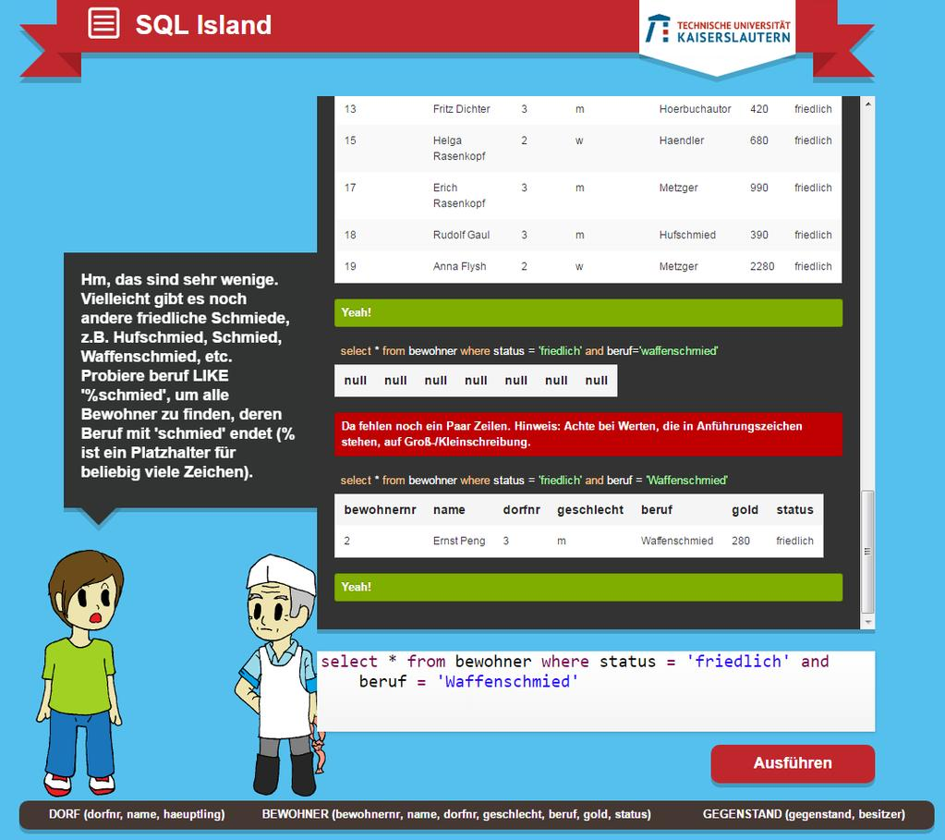
Sql island:

Slide 3
Some basic sql commands:
CREATE
SELECT
FROM
WHERE
DELETE
INSERT
UDPATE
DROP

Slide 4
Some Geosql functions:
ST_Area: returns the surface of a geometry
ST_Centroid: returns the centroid of a geometry
ST_Length: returns the length of a geometry
ST_Intersects: returns TRUE if the Geometries "spatially intersect"
ST_Within: returns true if the geometry A is completely inside geometry B

Slide 5
wkb
WKB (well-known binary) => used for storage in the DB
Example WKB:
"010100000077F82EB9658F1E411CFE2B475F59FC40"

Slide 6
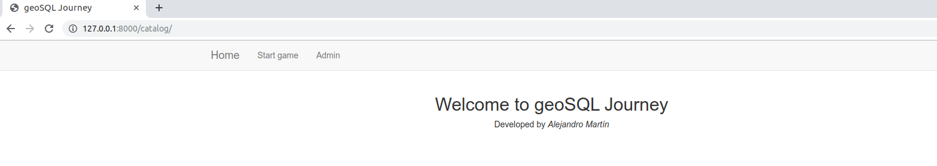
APPLICATION FUNCTIONALITY → hOME page

Slide 7
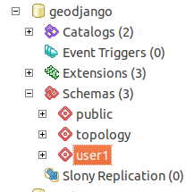
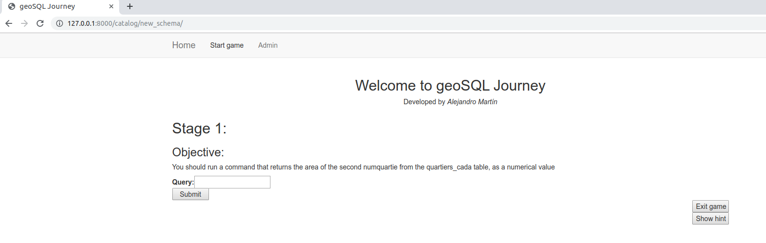
Starting game: first stage

Slide 8
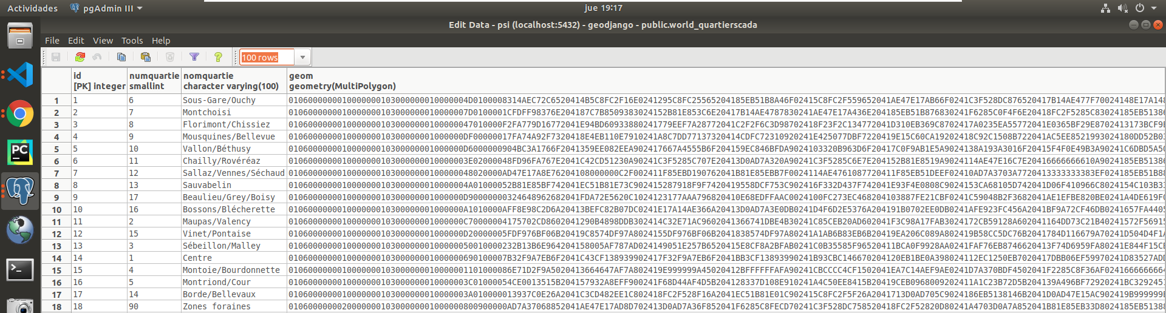
TABLE →quartierscada
← WKB Format
SELECT st_area(geom)
FROM quartierscada
WHERE numquartie = 2;

Slide 9
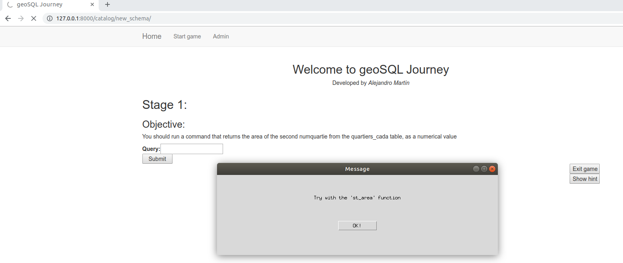
HINT SYSTEM

Slide 10
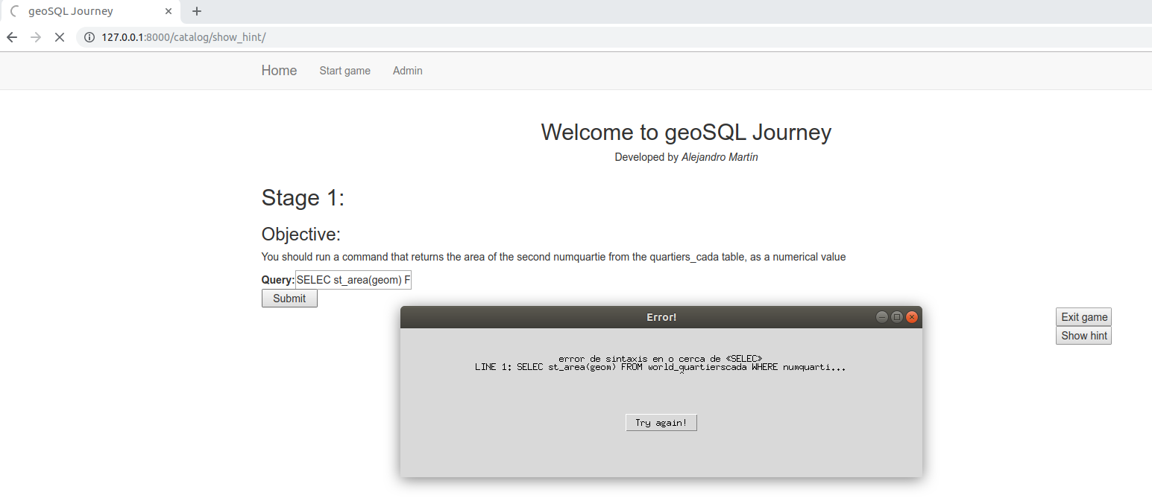
SYNTAX ERROR CONTROL

Slide 11
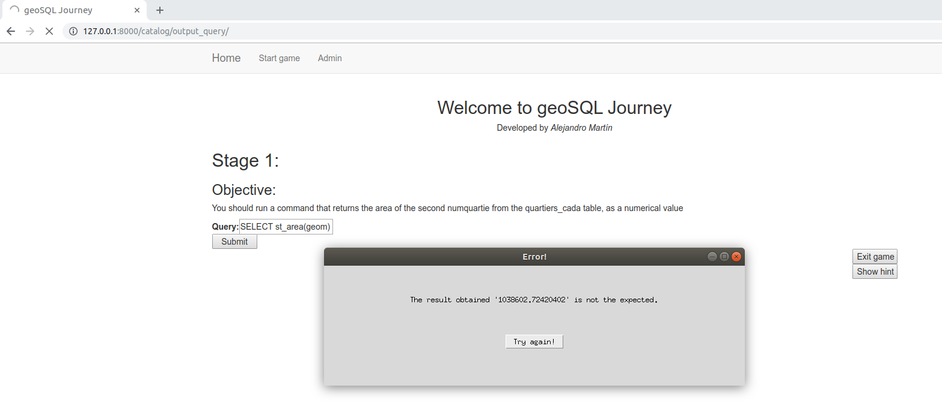
SEMANTIC ERROR CONTROL

Slide 12
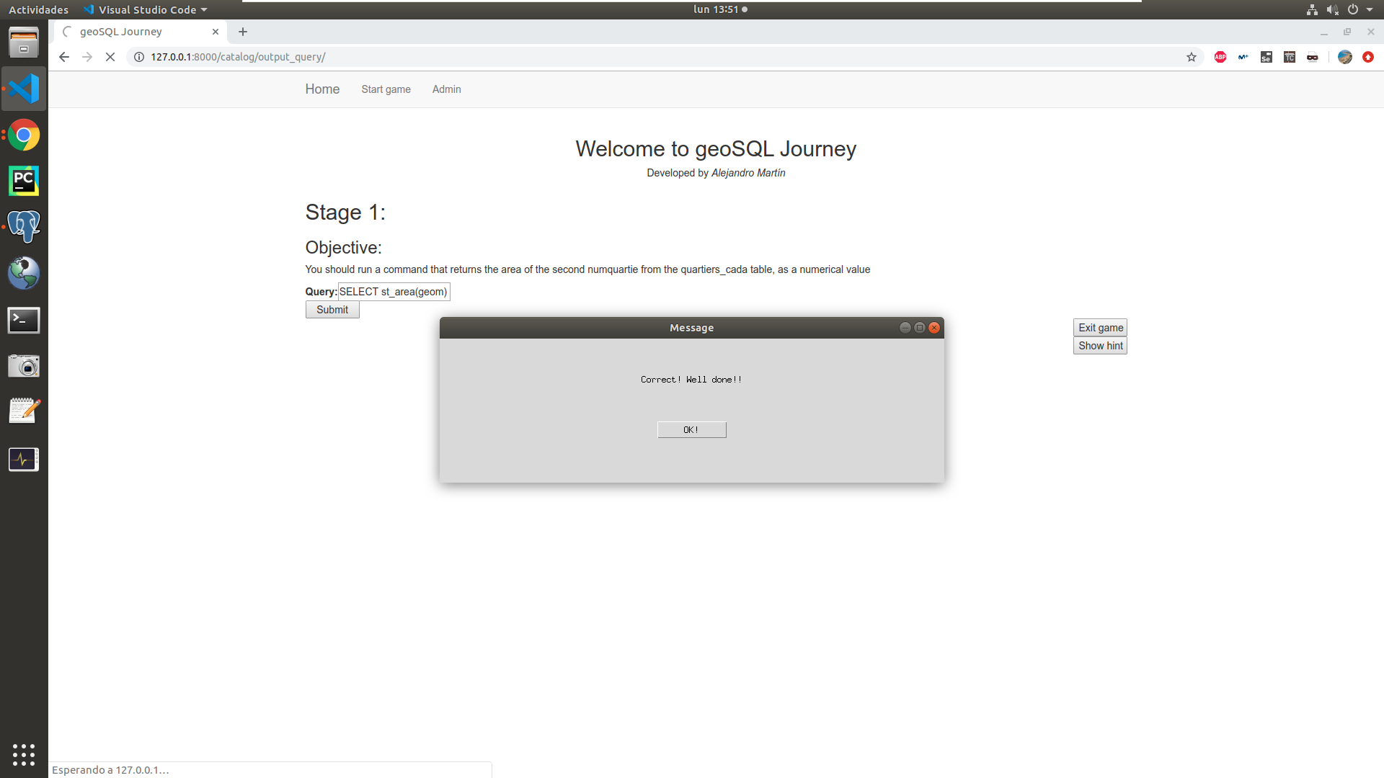
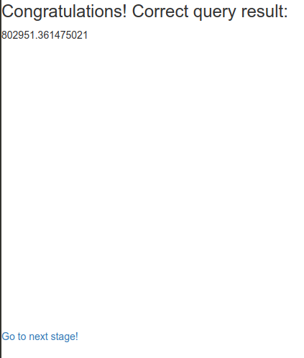
FIRST STAGE SUCCESS

Slide 13
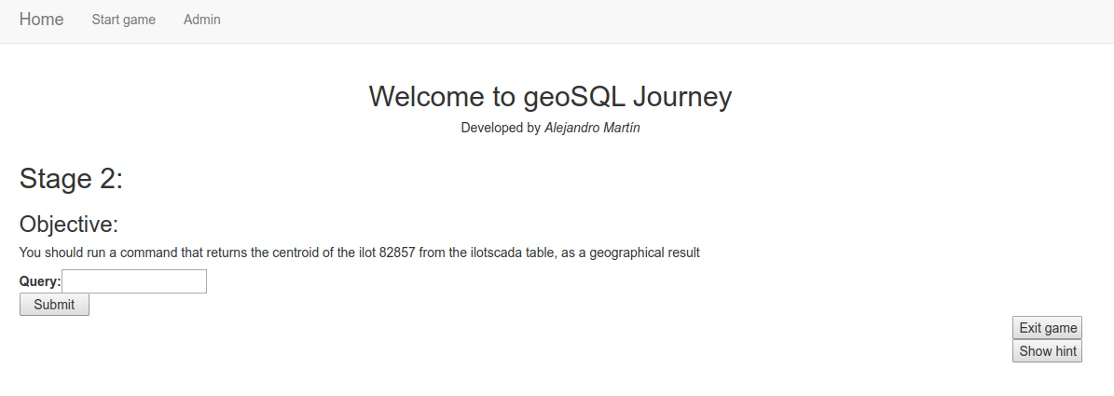
SECOND STAGE

Slide 14
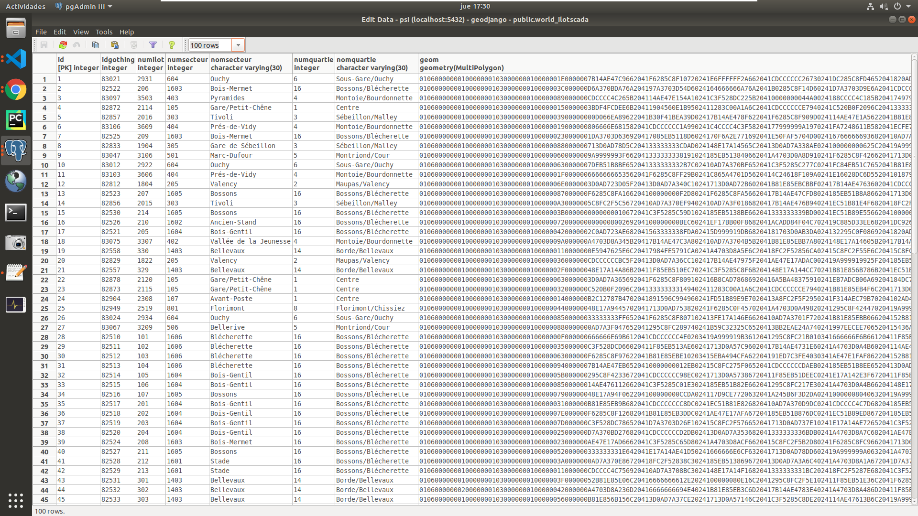
TABLE →ilotscada
← WKB Format

Slide 15
TABLE →ilotscada
← WKB Format
SELECT st_centroid(geom)
FROM ilotscada WHERE idgothing = 82857;

Slide 16
TABLE →ilotscada
← WKB Format
SELECT st_centroid(geom)
FROM ilotscada WHERE idgothing = 82857;

Slide 17
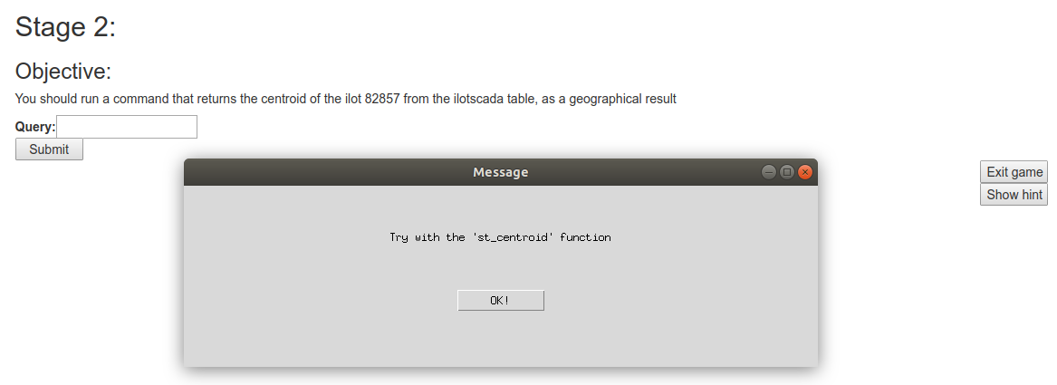
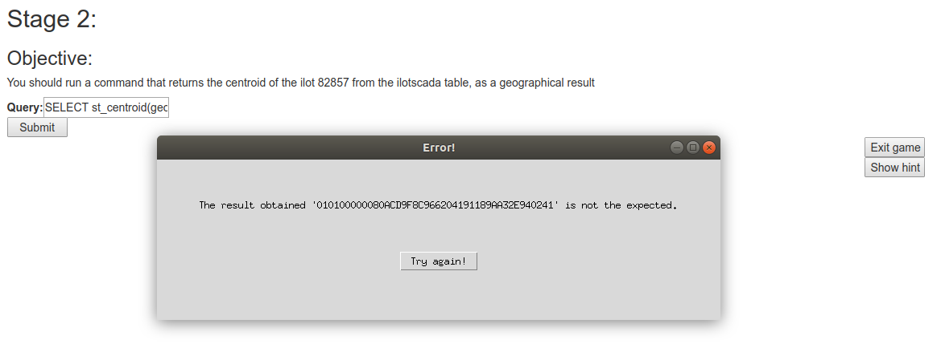
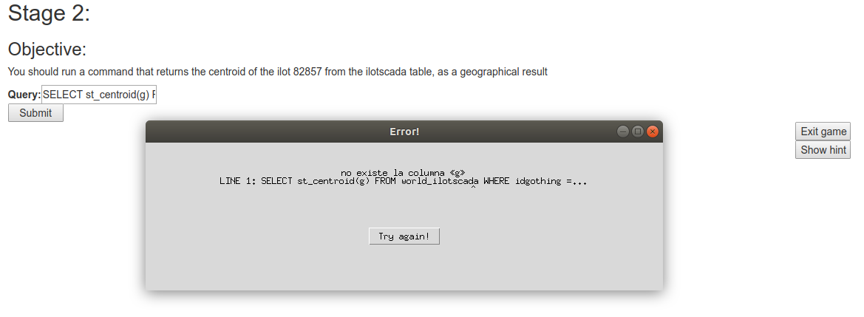
ERROR CONTROL

Slide 18
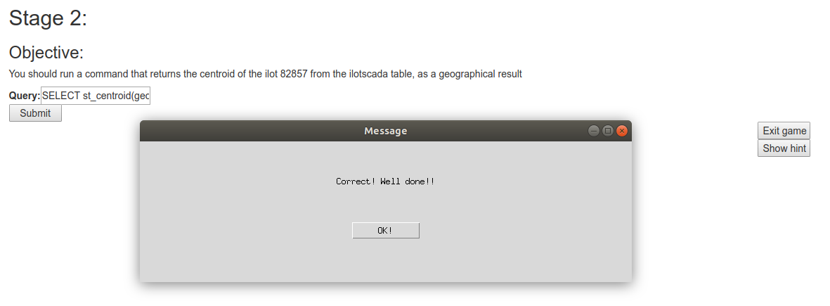
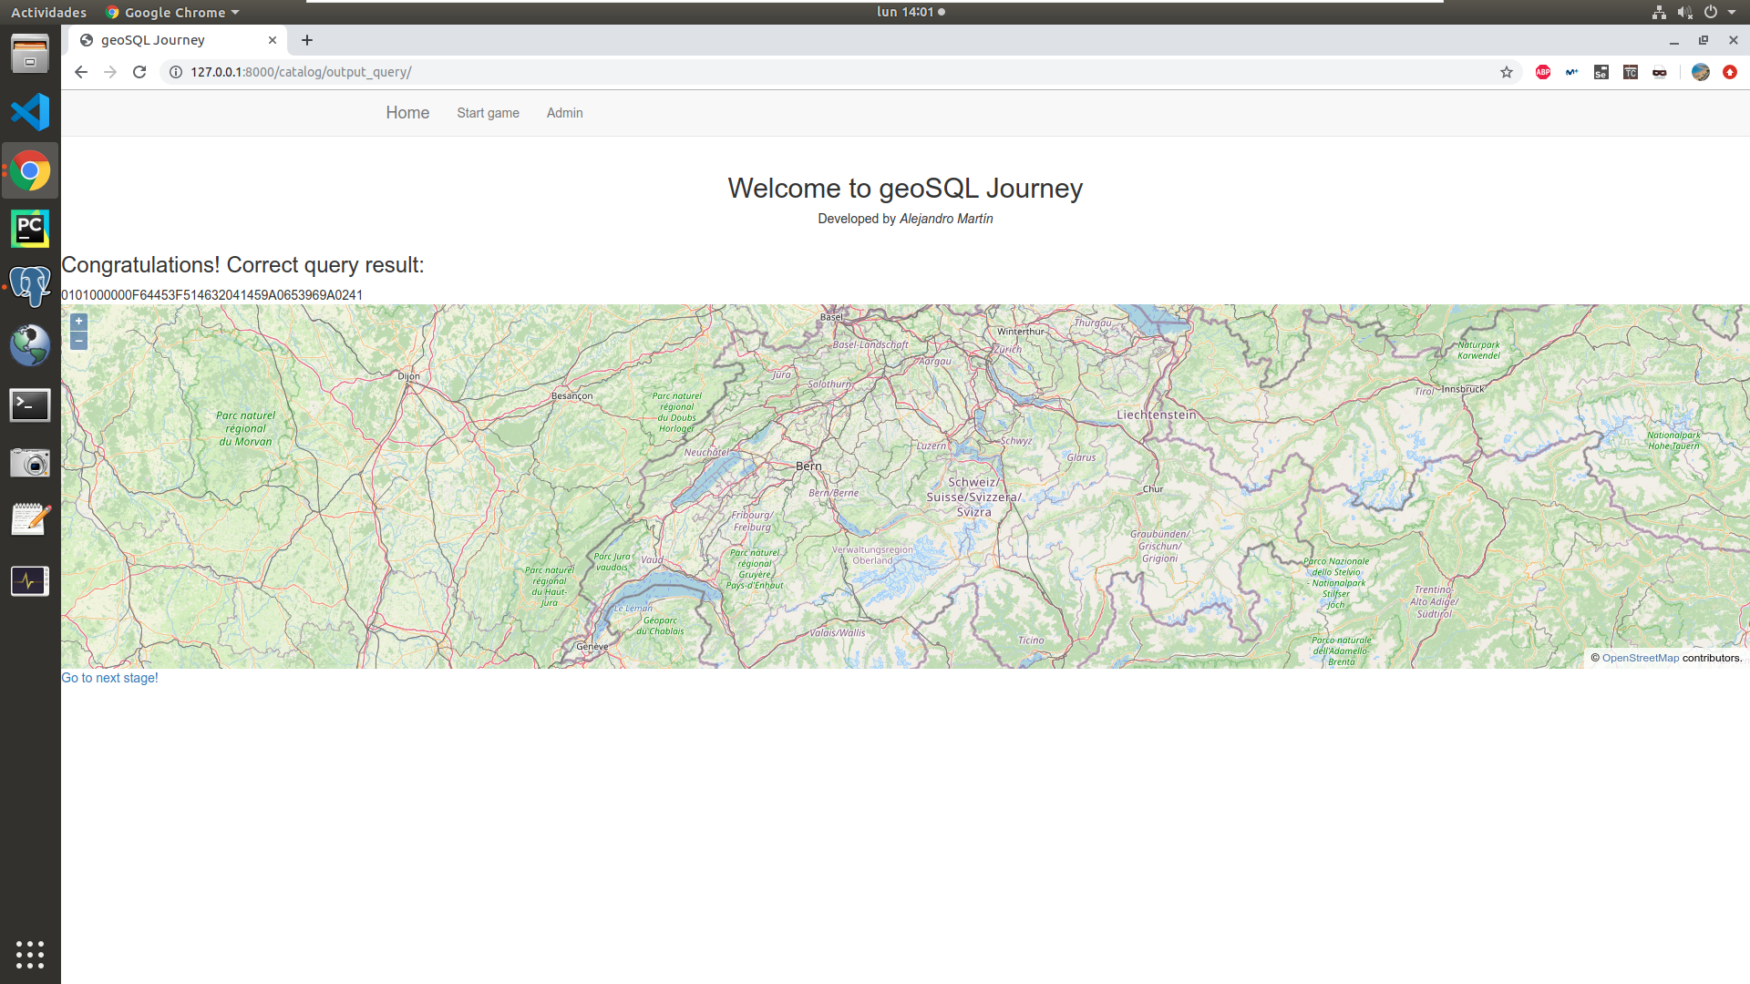
SECOND STAGE SUCCESS

Slide 19
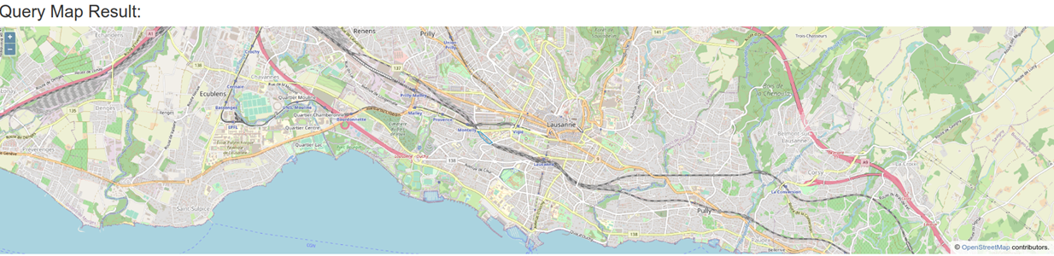
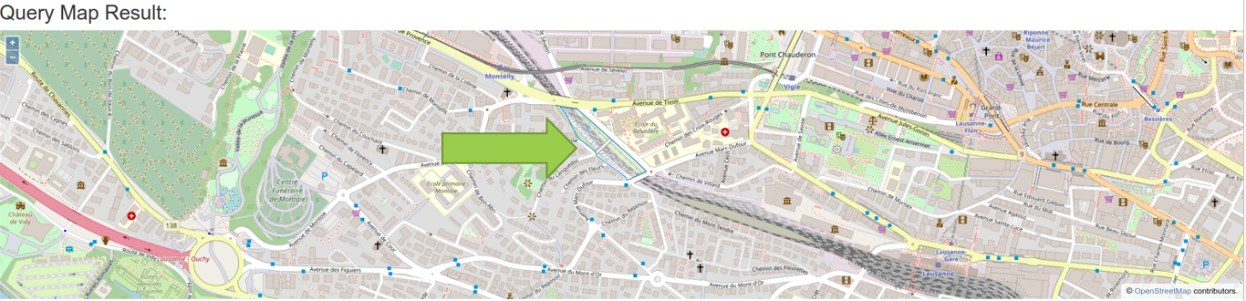

Slide 20
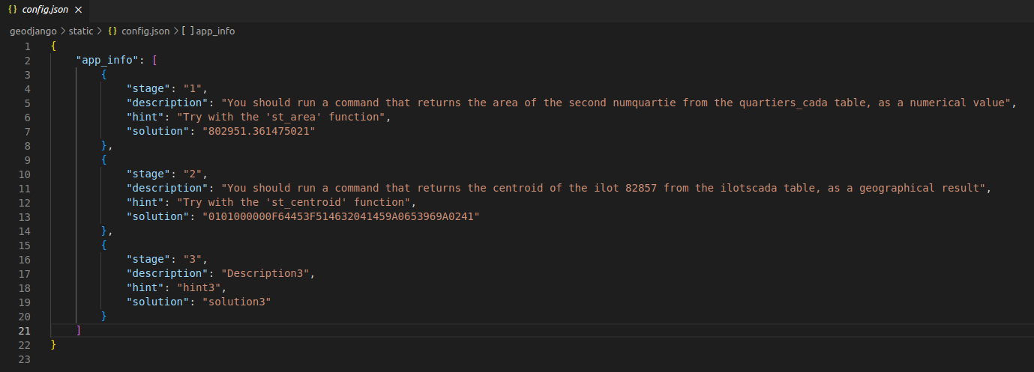
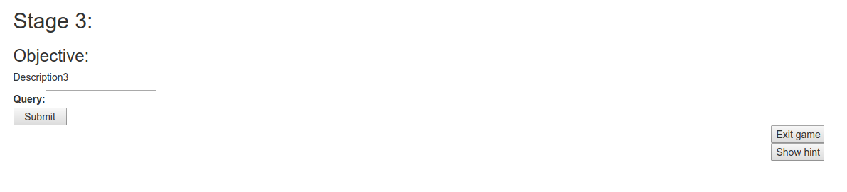
NEXT STAGE DYNAMIC

Slide 21
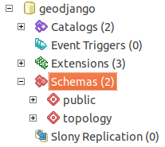
EXIT GAME

Slide 22
Thanks a lot! Merci beaucoup!

